Slide 1
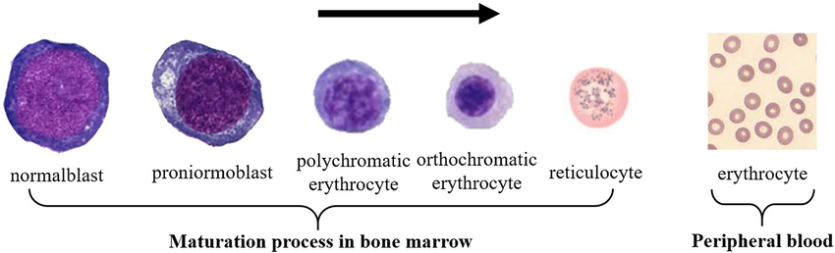
Unit 1: Introduction to Blood
Definition: Specialized connective tissue circulating in the cardiovascular system.
Composition: Cells (RBCs, WBCs, platelets) and plasma (water, proteins, electrolytes, hormones, waste).
Blood composition
Plasma is composed of 92% water, 7% proteins (albumin, globulins, fibrinogen), electrolytes, and waste products.
Specific gravity of blood is approximately 1.060, and viscosity is 4-5 times that of water.
ph- 7.35 to 7.45
Red Blood Cells (RBCs)
Production (erythropoiesis) occurs in red bone marrow, stimulated by erythropoietin.
Average lifespan is 120 days, with old RBCs removed by the spleen and liver.
Hb broken down into bilirubin.

Slide 2
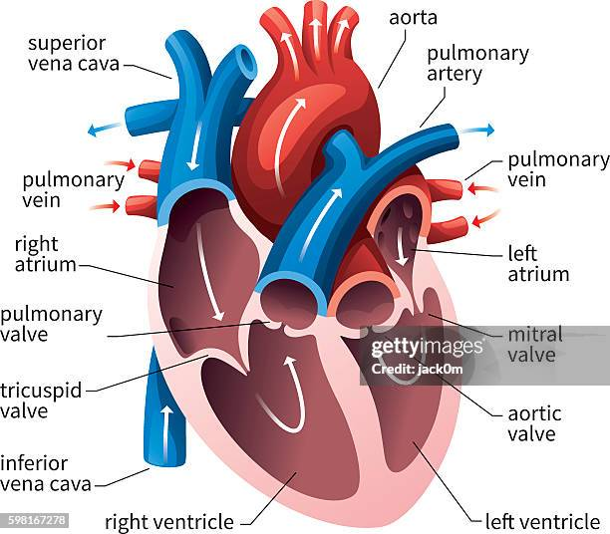
Hemoglobin
Structure: Four globin chains with iron-containing heme groups.
Types: HbA (adult hemoglobin), HbF (fetal hemoglobin).
Erythropoiesis occurs in red bone marrow
Functions: Oxygen transport, carbon dioxide transport, and pH regulation.
Derivatives of Hemoglobin
Carboxyhemoglobin: Hemoglobin bound to carbon monoxide, reducing oxygen transport.
Methemoglobin: Oxidized hemoglobin (Fe3+), cannot bind oxygen effectively.
Sulfhemoglobin: Hemoglobin with sulfur, reducing oxygen-carrying
capacity.
Heart Structure
Location: Thoracic cavity, left of the median plane.
Chambers: Atria and ventricles.
Valves:
  Atrioventricular: Tricuspid (right), mitral (left).
  Semilunar: Pulmonary (right), aortic (left).

Slide 3
Cardiac Conduction System
SA Node: Primary pacemaker.
AV Node: Relays impulses to ventricles.
Bundle of His and Purkinje Fibers: Conduct impulses through the ventricles.
Cardiac Cycle
Diastole: Relaxation phase where chambers fill with blood.
Systole: Contraction phase where blood is pumped out.
Cardiac Output and Regulation
Cardiac output (CO) = Heart Rate × Stroke Volume.
Factors influencing CO: Autonomic nervous system, venous return, blood volume.
Coronary Circulation
Coronary arteries supply blood to heart muscle.
During exercise, coronary blood flow increases to meet the oxygen demand of the heart.
Heart Sounds and Murmurs
S1: Closure of atrioventricular valves.
S2: Closure of semilunar valves.
Murmurs: Abnormal heart sounds, indicating heart disease.

Slide 4
Hemodynamics
Blood Flow: Determined by pressure gradients and resistance.
Resistance: Affected by vessel diameter, length, and viscosity.
Vasoconstriction: Increases resistance and blood pressure.
Regulation of Blood Pressure
Neurohormonal Control: Sympathetic nervous system and hormones (e.g., adrenaline).
Fluid Volume Control: Regulated by kidneys.
Circulatory Adjustments During Exercise
Increased CO: Heart rate and stroke volume rise.
Redistribution of Blood Flow: More blood to active muscles.
Muscle Physiology - Basic Unit
Muscle fibers consist of myofibrils containing actin and myosin.
Action potentials initiate muscle contraction through excitation-contraction coupling.

Slide 5
Muscle Action Potential
Excitation and Propagation:
Action potential travels along the sarcolemma and T-tubules, triggering calcium release.
Latent Period:
Time between action potential and contraction.
Refractory Period:
Time when muscle fibre cannot respond to a new stimulus.
Threshold Level:
Minimum stimulus required for action potential.
All-or-None Principle:
Muscle fibres contract fully or not at all.
Contractile Mechanism
Excitation-Contraction Coupling:Link between electrical excitation and muscle contraction.
Neuro-Muscular Transmission:Nerve impulse stimulates muscle contraction via neurotransmitter release (e.g., acetylcholine).

Slide 6
Muscle Contraction
Isometric Contraction: Muscle length remains the same, but tension increases
Isotonic Contraction: Muscle changes length (concentric and eccentric contraction)
Muscle Fatigue and Rigor Mortis
Muscle fatigue results from prolonged activity, causing decreased force generation
Rigor mortis is postmortem muscle stiffening due to a lack of ATP

Slide 7
Nervous System - Organization
Information processing: Reflexes to complex behaviors
Basic unit: Neuron, with dendrites, soma, and axon
Major Functional Systems
Sensory System:Processes sensory information.
Consciousness:Awareness of self and surroundings.
Emotion:
Regulation of emotional responses.
Motor Control:Coordination of movement.
Visceral Control: Regulation of internal organ functions.

Slide 8
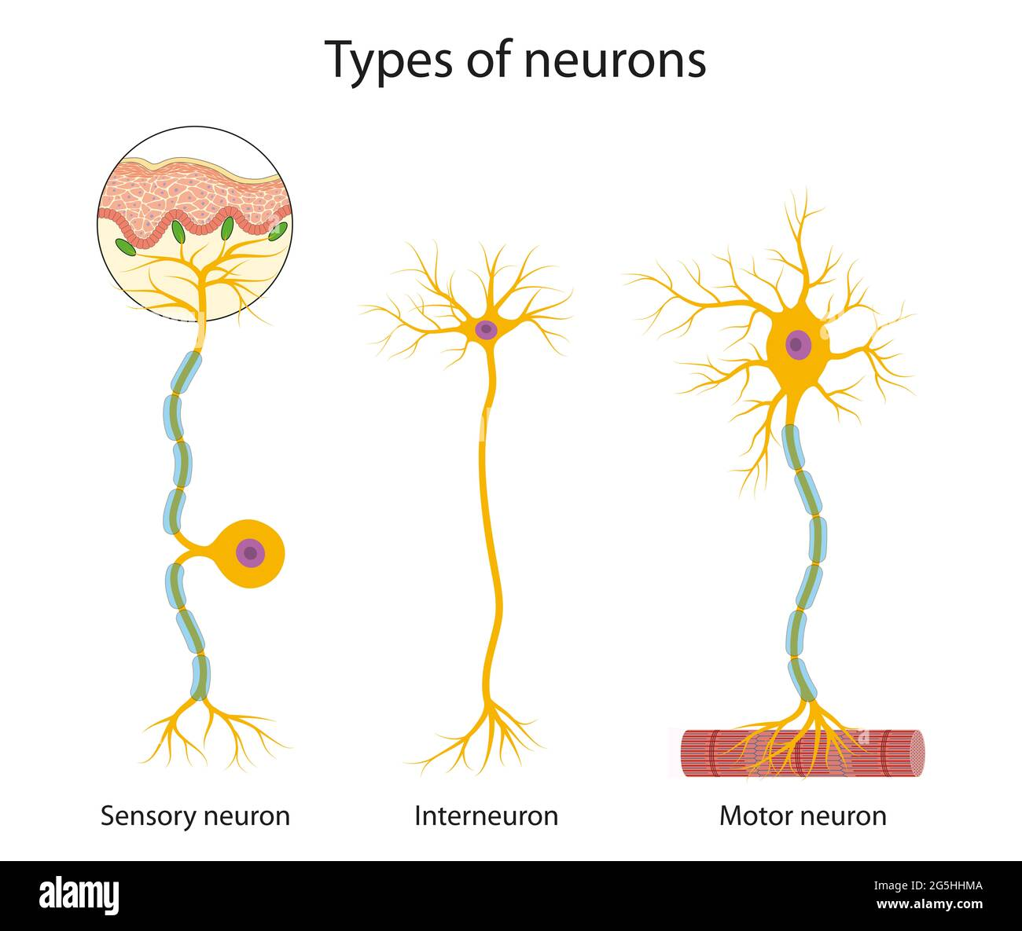
Neuron Types
Sensory neurons: Transmit sensory information
Motor neurons: Control muscle contractions
Interneurons: Connect other neurons
Resting membrane potential: -70mV
Action threshold potential: 50mV
Synaptic and Junctional Transmission
Synaptic transmission: Neurotransmitters released from one neuron to another
Junctional transmission: Communication between motor neurons and muscle fibers

Slide 9
Sense organs
Functions of the Nervous System
Reflexes:Automatic responses to stimuli
Control of Posture and Movements:Coordination for balance and movement
Autonomic Nervous System:Regulates involuntary functions (e.g., heart rate)
Neurotransmitters and Sleep Cycle
Neurotransmitters: Regulate sleep and wakefulness (e.g., GABA, serotonin)
Sleep Cycle: Stages of non-REM and REM sleep
Eye: Functional Morphology
Components:Cornea, lens, retina, optic nerve
Ear: Physiology of Hearing
Components:Outer ear (pinna), middle ear (ossicles), inner ear (cochlea)
Hearing Impairment: Includes conductive and sensorineural hearing loss
Neural Pathway:Light converted to electrical signals in the retina

Slide 10
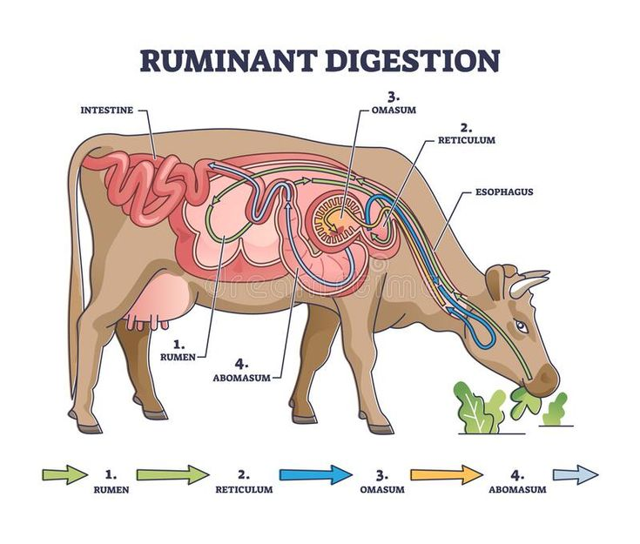
Unit 2 - Digestive System - Monogastric
Single-chambered stomach found in humans, pigs, and dogs
Digestion involves mouth, esophagus, stomach, small intestine, large intestine
Digestive System - Polygastric
Multi-chambered stomach with four compartments in ruminants (e.g., cattle, sheep)
Fermentation in the rumen breaks down fibrous materials
Prehension
Definition: Grasping or taking in food
Mechanism: Uses lips, tongue, and teeth
Adaptations: Varies by species (e.g., herbivores have grinding teeth)
Rumination
Definition: Regurgitating and re-chewing food
Process: Food enters the rumen, is regurgitated as cud,
re-chewed, and swallowed
Function: Enhances fiber breakdown and nutrient absorption

Slide 11
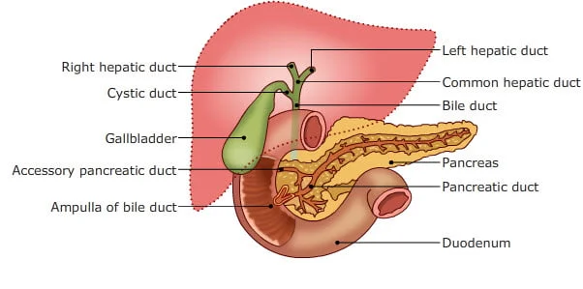
Defecation
Definition: Elimination of indigestible waste
Process: Waste moves from large intestine to rectum, then expelled
Regulation: Controlled by the nervous system
Vomition
Definition: Expelling stomach contents through the mouth
Mechanism: Triggered by irritation or overdistension
Physiological Response: Involves abdominal muscle contractions
Regulation of Secretory Functions
Salivary Secretion: Contains amylase; stimulated by food presence
Stomach Secretion: Gastric juices (HCl, pepsinogen) regulated by gastrin
Intestinal Secretion: Pancreatic enzymes and bile released; regulated by secretin and CCK
Bile Secretion
Function: Emulsifies fats for digestion
Production: Made in the liver, stored in the gallbladder.
Release: Triggered by fats in the intestine

Slide 12
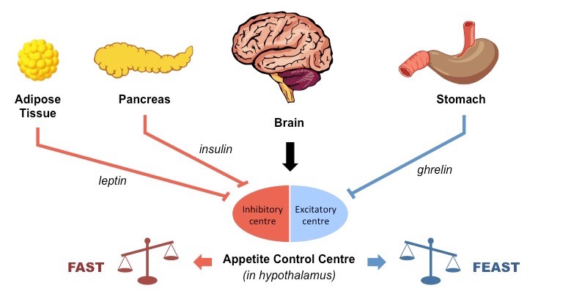
Hunger and Appetite Control
Hunger: Physiological need for food (regulated by ghrelin)
Appetite: Psychological desire to eat (influenced by
sensory stimuli)
Regulation: Involves brain and hormonal interactions
Developmental Aspects of Digestion
Growth Stages: Digestive systems evolve from young to adult
Weaning: Transition from milk to solid food affects digestion
Luminous, Membranous, and Microbial Digestion
Luminous Digestion: Enzymatic breakdown in the lumen
Membranous Digestion: Enzymes on intestinal membrane aid absorption
Microbial Digestion: Fermentation in the rumen by microbes
Permeability Characteristics of the Intestine
Intestinal Permeability: Ability to allow substances to pass.
Forces Governing Absorption: Includes diffusion and active transport.
Control of Electrolyte and Water Transport: Regulated by hormones.

Slide 13
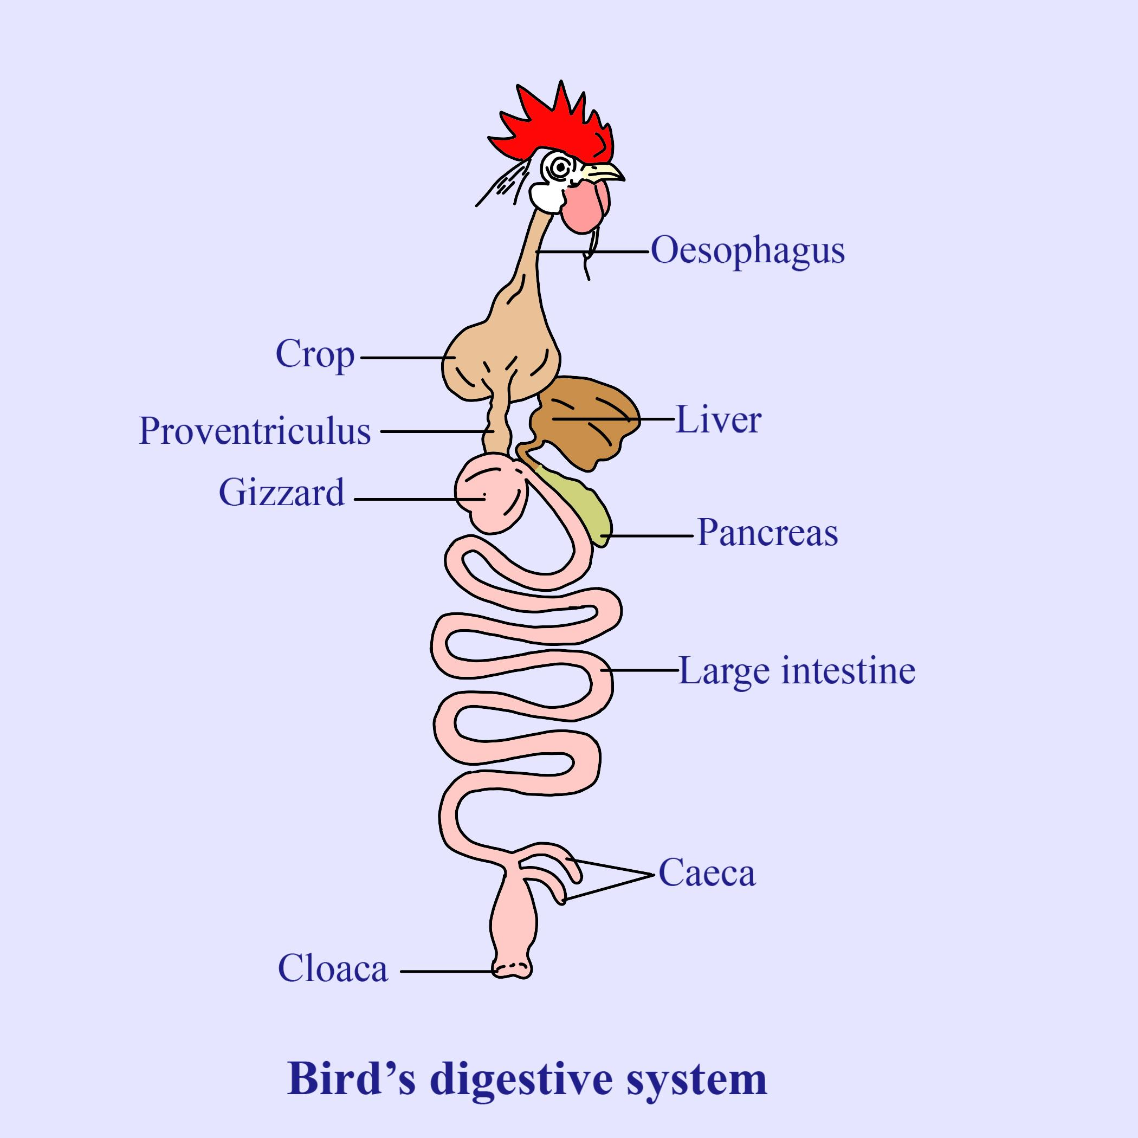
Digestion in Birds
Enzymatic vs. Fermentative Digestion
Monogastric Digestion: Enzymatic breakdown in stomach and intestine
Fermentative Digestion: Microbial fermentation in the rumen
Modification of Toxic Substances in Rumen
Detoxification: Rumen microbes modify harmful substances
Examples: Breakdown of secondary metabolites in plants
Anatomy of the Digestive System
• Beak: Adapted for feeding strategies, no teeth
• Crop: Stores and soaks food
• Proventriculus: Secretes gastric juices for digestion
• Gizzard: Mechanically grinds food
• Ceca: Aid in fermentation and nutrient absorption

Slide 14
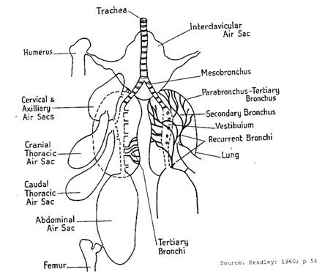
Digestive Process
Mechanical digestion in gizzard
Chemical digestion begins in proventriculus
Enzymatic digestion in small intestine
Absorption primarily in small intestine, some in ceca
Unique Features
Absence of teeth, gizzard compensates
Crop allows quick feeding and delayed digestion
Ceca important for herbivores, break down complex carbs
Rapid digestion compared to mammals
Respiratory System – Birds
Lungs connected to air sacs facilitate continuous airflow
Birds have cross-current gas exchange for efficient respiration
Respiratory Process
Unidirectional airflow through lungs and air sacs
Cross-current exchange for efficient gas exchange
Exhalation pushes out carbon dioxide-rich air

Slide 15
Adaptations for Flight
Lightweight structure of respiratory system
Efficient gas exchange supports high metabolic rate
Continuous airflow ensures oxygen supply during flight
Functional Morphology of the Respiratory Apparatus
Upper Tract: Nasal cavity, pharynx, larynx
Lower Tract: Trachea, bronchi, bronchioles, alveoli
Components of the Respiratory System
External Respiration: O2/CO2 exchange between alveoli and blood
Internal Respiration: O2/CO2 exchange between blood and tissues
Gas Exchange
Lungs: Main organs for gas exchange
Ventilatory Muscles: Diaphragm, intercostals
Evolutionary Adaptations
Aspiration Breathing: Gills to lungs in terrestrial vertebrates
Air Sacs in Birds: Allow continuous airflow through lungs

Slide 16
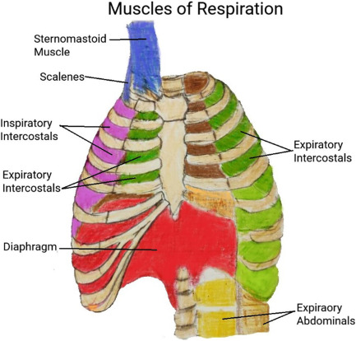
Mechanics of Breathing
Inhalation: Diaphragm contracts, increasing thoracic volume, drawing air in
Exhalation: Diaphragm relaxes, decreasing thoracic volume, expelling air
Muscle Involvement in Breathing
Diaphragm: Primary muscle for inhalation
Intercostals: Assist in expanding and contracting rib cage
Control of Breathing
Neural Regulation: Respiratory centers in brain
Chemical Regulation: Chemoreceptors monitor CO2 and O2 levels
Respiratory Volumes
Tidal Volume: Amount of air inhaled/exhaled in normal breath
Vital Capacity: Maximum air exhaled after maximum inhalation
Residual Volume: Amount of air remaining in lungs after exhalation

Slide 17
Fetal and Neonatal Oxygen Transport
Transport of Blood Gases - Oxygen Transport
98.5% bound to hemoglobin
1.5% dissolved in plasma
Oxyhemoglobin dissociation curve is affected by pH, temperature, CO2
Transport of Blood Gases - Carbon Dioxide Transport
70% as bicarbonate ions
20-23% as carbaminohemoglobin
7-10% dissolved in plasma
Fetal hemoglobin has higher oxygen affinity
Fetal circulation bypasses lungs
Ductus arteriosus and foramen ovale close after birth

Slide 18
Mechanics of Breathing
Breathing Process
Inhalation: Diaphragm contracts, decreasing intrapulmonary pressure, drawing air in
Exhalation: Diaphragm relaxes, increasing intrapulmonary pressure, expelling air
Muscle Involvement
Diaphragm: Primary muscle for inhalation
Intercostals: Assist in expanding and contracting rib cage
Control of Breathing
Neural regulation by respiratory centers in brain
Chemical regulation by chemoreceptors monitoring CO2 and O2 levels
Diffusion and Perfusion
Gases move by diffusion based on partial pressure gradients
Blood flow (perfusion) is essential for gas exchange

Slide 19
Hypoxia
Insufficient oxygen available to tissues
Types: Hypoxic, anemic, ischemic
Airflow Resistance
Airway diameter, length, and smooth muscle contraction affect resistance
Bronchoconstriction increases resistance
Respiratory Adaptations
Panting increases evaporative cooling
Exercise increases oxygen demand, breathing rate and depth
High altitude reduces oxygen availability, stimulating increased breathing
Non-Respiratory Functions
Metabolism of substances
Immune defense mechanisms
Maintaining acid-base balance

Slide 20
UNIT-3: Excretory and Endocrine Systems

Slide 21
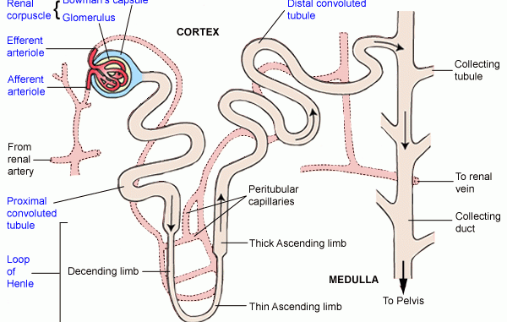
Functional Morphology of Nephrons
Nephron Structure:
Renal Corpuscle: Glomerulus + Bowman's capsule
Proximal Convoluted Tubule: Major site for reabsorption
Loop of Henle:
- Descending Limb: Water permeable, solute impermeable
- Ascending Limb: Solute permeable, water impermeable
Distal Convoluted Tubule: Further modification of filtrate
Collecting Duct: Final urine concentration
Glomerular Filtration Barrier
Fenestrated Endothelium: Allows passage of water/solutes
Basement Membrane: Composed of collagen and laminin
Podocytes: Have filtration slits to prevent large molecule passage

Slide 22
Factors Determining Filtration Pressure
Hydrostatic Pressures:
Glomerular Hydrostatic Pressure (~55-60 mmHg) favors filtration
Bowman's Capsule Hydrostatic Pressure (~10-15 mmHg) opposes filtration
Oncotic Pressures:
Glomerular Capillary Oncotic Pressure (~25-30 mmHg) opposes filtration
Bowman's Capsule Oncotic Pressure: Negligible effect
Determination of Glomerular Filtration Rate (GFR)
Measurement
Inulin Clearance: Gold standard for GFR
Creatinine Clearance: Commonly used estimate
Factors Affecting GFR
Renal Blood Flow: Autoregulated
Glomerular Permeability: Affected by diseases
Hydrostatic and Oncotic Pressures: Systemically influenced

Slide 23
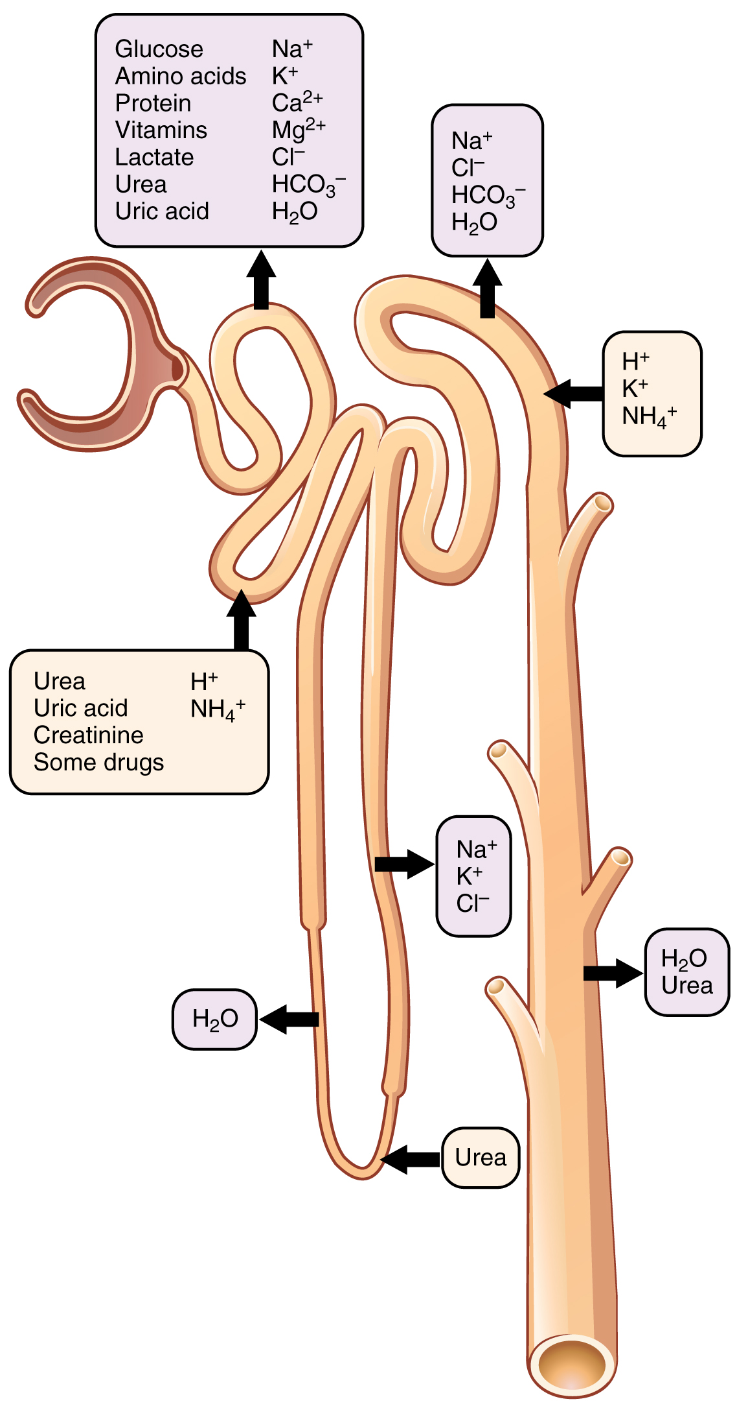
Renal Plasma Flow
Measurement:
PAH Clearance: Estimates effective renal plasma flow (ERPF)
Factors Affecting Renal Plasma Flow:
Sympathetic Nervous System: Causes vasoconstriction
Renin-Angiotensin-Aldosterone System: Increases blood pressure
Prostaglandins: Promote vasodilation
Reabsorption Mechanisms
Glucose Reabsorption:
SGLT2: Sodium-glucose cotransporter in proximal tubule.
GLUT2: Facilitated diffusion into blood.
Protein and Amino Acid Reabsorption:
Endocytosis: Uptake of filtered proteins.
Transporters: Reabsorb amino acids.
Electrolyte Reabsorption:
Sodium-Potassium ATPase: Establishes gradients.
Paracellular and Transcellular Pathways: For solute and water reabsorption.

Slide 24
Ammonium Mechanism
Glutamine Metabolism: Produces ammonium (NH4+) in proximal tubule
Ammonium Excretion: Maintains acid-base balance
Glomerulo-Tubular Balance
Autoregulation: Maintains constant GFR
Tubuloglomerular Feedback: Regulates GFR based on distal flow
Methods of Studying Renal Function
Clearance Techniques: Measure GFR and renal plasma flow
Micropuncture Studies: Assess pressures and concentrations
Microperfusion Studies: Evaluate reabsorption/secretion
Renal Biopsy: Histological examination of kidney tissue
Endocrine System - Hormonal Regulation
Hormones like parathyroid hormone (PTH), calcitonin, and insulin regulate calcium levels, metabolism, and blood glucose
Hormonal balance is maintained via negative feedback mechanisms

Slide 25
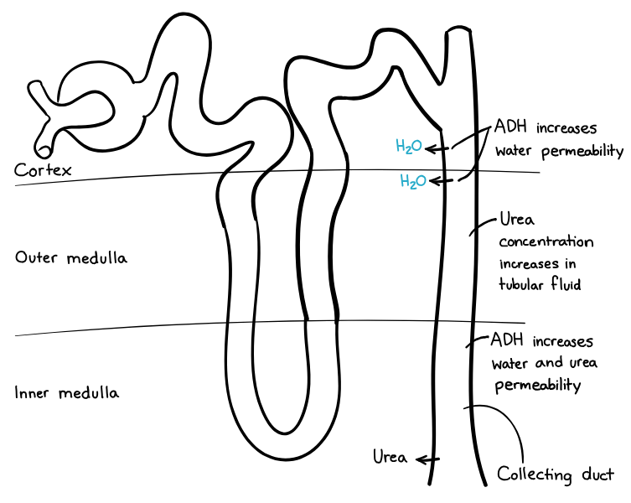
Urine Concentration
Countercurrent Multiplication:
Descending Limb: Water reabsorption.
Ascending Limb: Solute reabsorption.
Countercurrent Exchange:
Vasa Recta: Maintains osmotic gradient.
ADH: Increases water permeability in collecting duct
Micturition
Storage Phase: Bladder filling and pressure increase
Voiding Phase: Detrusor muscle contracts; sphincters relax
Uremia
Definition: Buildup of waste products in blood due to kidney failure
Causes: Chronic kidney disease, end-stage renal disease
Symptoms: Nausea, fatigue, confusion, pruritus
Treatment: Dialysis (hemodialysis or peritoneal) and kidney transplantation

Slide 26
Fluid and Water Balance
Total Body Water (TBW): 50-60% of body weight in adults, 70-75% in neonates
ICF: 2/3 of TBW
ECF: 1/3 of TBW, divided into plasma and interstitial fluid
Water Intake: Drinking water, food moisture, metabolic water
Water Output: Urine, feces, respiration, sweat
ADH: Increases water reabsorption in kidneys
Thirst Mechanism: Stimulates drinking in response to dehydration
Kidneys: Regulate water excretion based on body needs
Fluid Therapy
Indications: Dehydration, electrolyte imbalances, acid-base disturbances, maintenance
Types of Fluids: Crystalloids (isotonic, hypotonic, hypertonic), colloids (synthetic, natural)
Administration Routes: IV, SC, IO, oral
Monitoring: Vital signs, physical exam, urine output, laboratory tests

Slide 27
Dehydration
Causes: Excessive fluid loss, inadequate intake, increased insensible loss
Clinical Signs: Dry mucous membranes, skin tenting, lethargy, sunken eyes, tachycardia
Treatment: Fluid resuscitation, electrolyte correction, treat underlying causes
Water Concentration Mechanisms
Countercurrent Multiplication: Loop of Henle generates medullary gradient
Countercurrent Exchange: Vasa recta maintain gradient
ADH: Increases water permeability in collecting duct
Urea Recycling: Contributes to medullary gradient
Clinical Relevance
Monitoring Fluid Balance: Assess hydration status regularly
Fluid Therapy Protocols: Individualized based on condition
Uremia: Accumulation of waste products in blood due to kidney failure

Slide 28
Importance of Acid-Base Balance
pH Regulation: Maintains blood pH between 7.35 and 7.45
Physiological Processes: Essential for enzyme activity, oxygen transport, and metabolic functions
Mechanisms of Regulation
1. Buffer Systems:
Bicarbonate Buffer System: Main buffer in extracellular fluid.
Phosphate Buffer System: Operates in intracellular fluid and urine.
Protein Buffers: Proteins bind H⁺ ions to stabilize pH.
2. Respiratory Regulation:
Adjusts blood pH by changing CO₂ elimination (hyperventilation increases pH; hypoventilation decreases pH).
3. Renal Regulation:
Kidneys excrete/reabsorb H⁺ ions and bicarbonate to maintain pH balance.

Slide 29
Correction of Imbalances
Acidosis:
Metabolic Acidosis: Treat by addressing the cause and possibly administering bicarbonate.
Respiratory Acidosis: Improve ventilation.
Alkalosis:
Metabolic Alkalosis: Correct underlying causes; may need electrolyte replacement.
Respiratory Alkalosis: Use rebreathing techniques to increase CO₂.
Monitoring of Acid-Base Balance
Arterial Blood Gas Analysis: Assesses pH, pCO₂, and HCO₃⁻ levels
Anion Gap: Identifies unmeasured anions in metabolic acidosis

Slide 30
Total Osmotic Pressure - Definition and Components
Definition: Osmotic pressure is the pressure required to prevent water flow across a semipermeable membrane due to solute concentration differences.
Components:
Electrolytes: Sodium, potassium, chloride, bicarbonate contribute to osmotic pressure
Proteins: Plasma proteins (e.g., albumin) create colloidal osmotic pressure

Slide 31
Regulation and Clinical Significance
Kidneys adjust water and electrolyte excretion/reabsorption to maintain osmotic balance
Fluid Shifts: Osmotic pressure influences water movement between compartments
Clinical Significance:
Edema: Low osmotic pressure leads to fluid accumulation in tissues
Dehydration: Excessive fluid loss increases osmotic pressure in blood

Slide 32
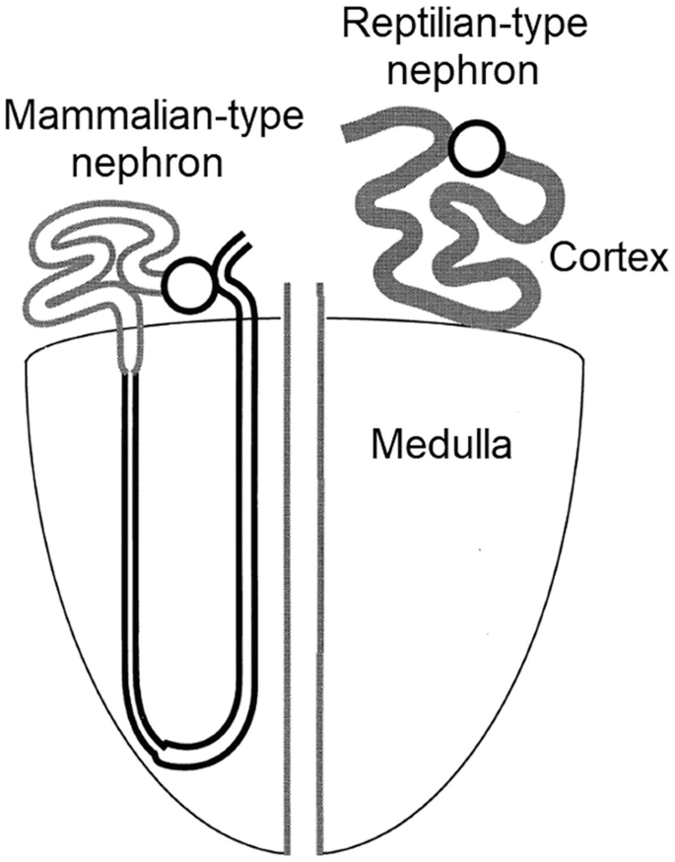
Measurement of Osmotic Pressure
Colloid Osmotic Pressure (COP): Normal range is 21-25 mmHg, indicating plasma protein effectiveness
Types of Nephrons
Reptilian-Type Nephrons:
Cortical location, lack loop of Henle,
no urine concentration capacity
Mammalian-Type Nephrons:
Medullary location,
contain loop of Henle,
capable of urine concentration

Slide 33
Formation of Urine
Filtration: Blood filtered in glomeruli
Reabsorption: In mammalian-type nephrons
Uric Acid Production: Main nitrogenous waste
Ureter and Cloaca
Ureters: Transport urine to cloaca
Cloaca: Common outlet for urinary, digestive, and reproductive systems
No urinary bladder: Urine not stored

Slide 34
Post-Renal Modification
Water and electrolyte reabsorption in cloaca
Helps maintain hydration
Key Features of Avian Urine
Thick, pasty consistency
High uric acid concentration
Semi-solid paste excretion
Renal Portal System
Blood from hind limbs and tail directed to kidneys
Aids fluid and electrolyte balance regulation

Slide 35
Cerebrospinal Fluid (CSF)
Clinical Relevance of Kidney Health
• Kidney health crucial for overall health
• High-protein diets can lead to gout
Composition:
Water: Main component (99%)
Electrolytes: Na⁺, K⁺, Cl⁻, Ca²⁺, Mg²⁺, HCO₃⁻, glucose
Proteins: Low concentration, primarily albumin and immunoglobulins

Slide 36
Formation and Flow of CSF
Choroid Plexus: Filtration of blood plasma
Ependymal Cells: Produce and circulate CSF
Flow:
Ventricular System: Lateral → third → fourth ventricle
Subarachnoid Space: Around brain and spinal cord
Arachnoid Granulations: Reabsorption into bloodstream

Slide 37
Functions of CSF
Cushioning: Protects brain and spinal cord
Buoyancy: Reduces brain weight
Nutrient Transport: Delivers nutrients, removes waste
Synovial Fluid - Composition
Water: Main component, provides lubrication
Hyaluronic Acid: Viscous properties
Lubricin: Lubricates joint surfaces
Electrolytes: Similar to plasma, lower protein
Cells: Synoviocytes, few white blood cells

Slide 38
Synovial Fluid - Formation and Functions
Formation:
Synovial Membrane: Filtration and secretion.
Flow:
Joint Cavity: Lubricates articular surfaces.
Nutrient Exchange: Supplies nutrients, removes waste.
Functions:
Lubrication: Reduces friction during movement.
Shock Absorption: Distributes loads across joints.
Nutrient Supply: Provides nutrients to cartilage.

Slide 39
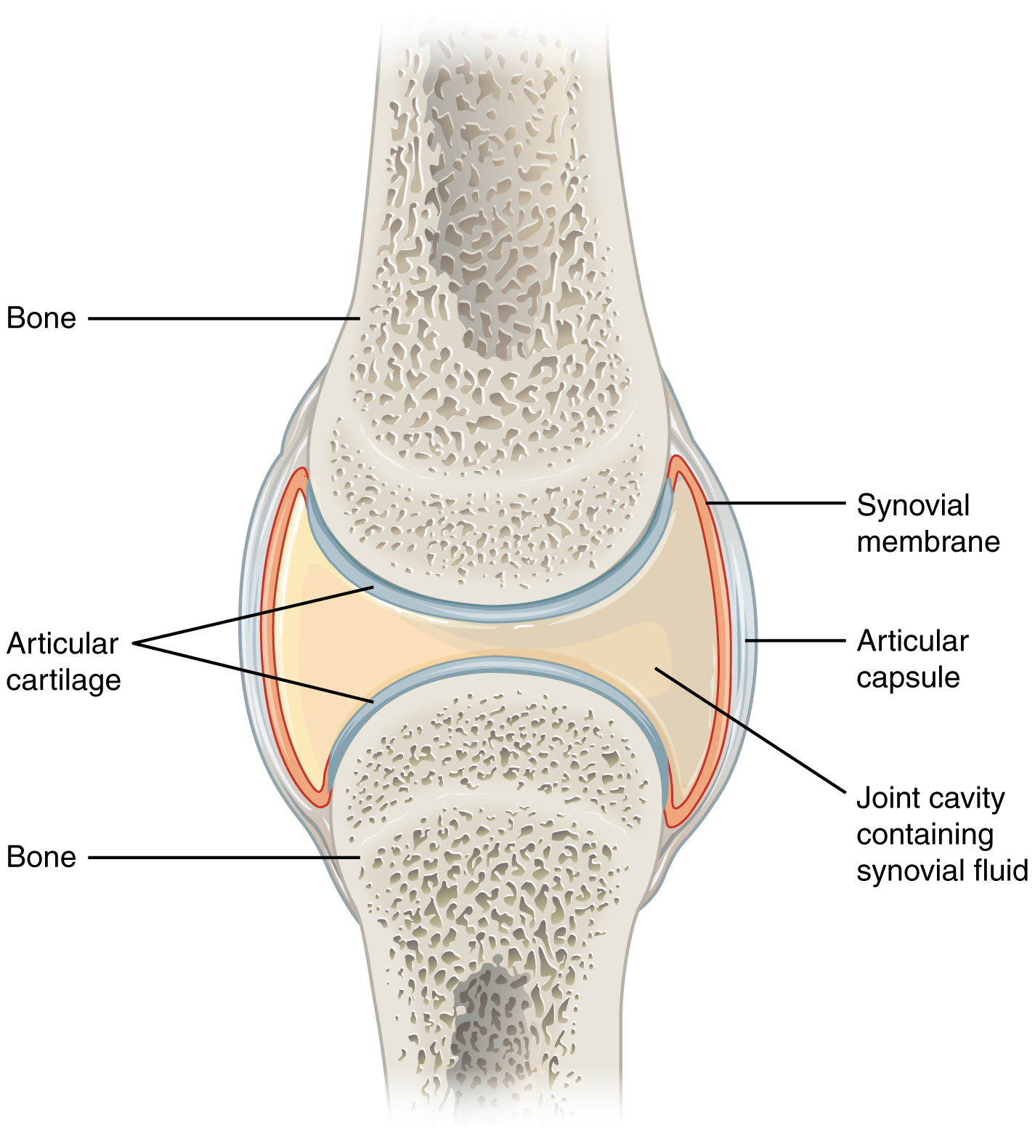
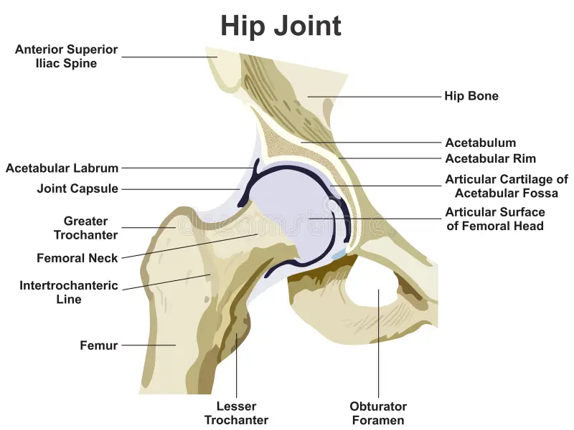
Classification of Joints
Structural: Fibrous, cartilaginous, synovial
Functional: Synarthrosis, amphiarthrosis, diarthrosis
Types of Synovial Joints
Ball and Socket: Shoulder, hip
Hinge: Elbow, knee
Pivot: Atlantoaxial
Condyloid: Wrist
Saddle: Thumb
Gliding: Wrist, ankle

Slide 40
Functions of Joints
Facilitate Movement: Flexion, extension, rotation
Provide Stability: Maintain skeletal integrity
Shock Absorption: Absorb impact during activities
Joint Disorders
Arthritis, bursitis, luxation
Regulation of Bone Metabolism and Homeostasis
Bone Functions: Structural support, protection, movement, mineral reservoir
Dynamic Process: Continuous remodeling through bone resorption and formation

Slide 41
Hormonal Regulation of Bone Metabolism
1. Parathyroid Hormone (PTH):
Increases blood calcium by stimulating osteoclasts and enhancing renal reabsorption.
2. Calcitonin:
Lowers blood calcium by inhibiting osteoclast activity.
3. Vitamin D (Calcitriol):
Promotes intestinal absorption of calcium and phosphate.
4. Estrogen:
Inhibits osteoclast activity; deficiency can lead to osteoporosis.
5. Growth Hormone (GH):
Stimulates bone growth through IGF-1 production.

Slide 42
Hormone-Cell Interaction and Sub-Cellular Mechanisms
Receptors: Target cells must have specific receptors for hormones.
Mechanisms:
Lipid-Soluble Hormones: Bind to intracellular receptors.
Water-Soluble Hormones: Bind to cell surface receptors, activating second messengers.
Sub-Cellular Mechanisms:
Synthesis and Secretion: Hormones produced in endocrine glands and secreted into the bloodstream
Metabolism: Hormones metabolized in liver and kidneys for inactivation or excretion
Feedback Mechanisms: Primarily negative feedback loops maintain hormone levels

Slide 43
Methods of Studying the Endocrine System
Hormone Measurement: RIA and ELISA for quantifying hormone levels
Immunohistochemistry: Visualizes hormone-producing cells
Genetic Studies: Knockout/transgenic models to study hormone functions
Chemistry of Hypothalamo-Hypophyseal Hormones
Hypothalamus: Produces releasing and inhibiting hormones
Pituitary Gland:
Anterior Pituitary: GH, PRL, ACTH, TSH, LH, FSH
Posterior Pituitary: ADH and oxytocin

Slide 44
Target Organs and Hormones
Pineal Gland: Produces melatonin (regulates sleep)
Thyroid Gland: Produces T4 and T3 (regulates metabolism)
Thymus: Produces thymosin (T-cell development)
Pancreas: Produces insulin and glucagon (regulates blood glucose)
Adrenal Glands: Produce cortisol, aldosterone, catecholamines (stress response)
Prostaglandins: Local hormones involved in inflammation and smooth muscle contraction

Slide 45
Hormones of Calcium Metabolism
PTH: Increases blood calcium
Calcitonin: Decreases blood calcium
Vitamin D: Enhances calcium absorption
Disorders Related to Hormonal Regulation
Hyperparathyroidism: Excess PTH leads to high blood calcium
Hypoparathyroidism: Low PTH results in low blood calcium
Thyroid Disorders: Hyperthyroidism (excess) and hypothyroidism (deficiency)
Adrenal Disorders: Cushing's syndrome (excess cortisol) and Addison's disease (insufficient cortisol)

Slide 46
Renin-Angiotensin System and Atrial Natriuretic Factors
Renin: Converts angiotensinogen to angiotensin I, leading to increased blood pressure.
Atrial Natriuretic Peptide (ANP): Promotes sodium excretion and reduces blood volume
Erythropoietin and Gastrointestinal Hormones
Erythropoietin: Produced by kidneys, stimulates red blood cell production
Gastrin: Stimulates gastric acid secretion
Cholecystokinin (CCK): Promotes bile and digestive enzyme release
Secretin: Stimulates bicarbonate secretion from the pancreas
Pheromones
Chemical Signals: Used for communication between individuals of the same species

Slide 47
UNIT 4
REPRODUCTION, LACTATION, GROWTH AND ENVIRONMENTAL PHYSIOLOGY

Slide 48
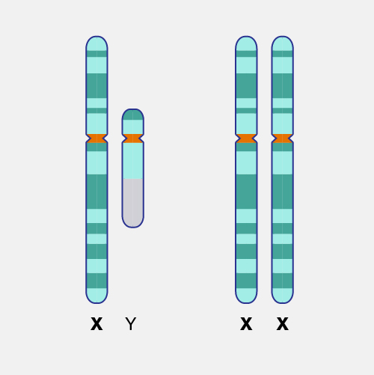
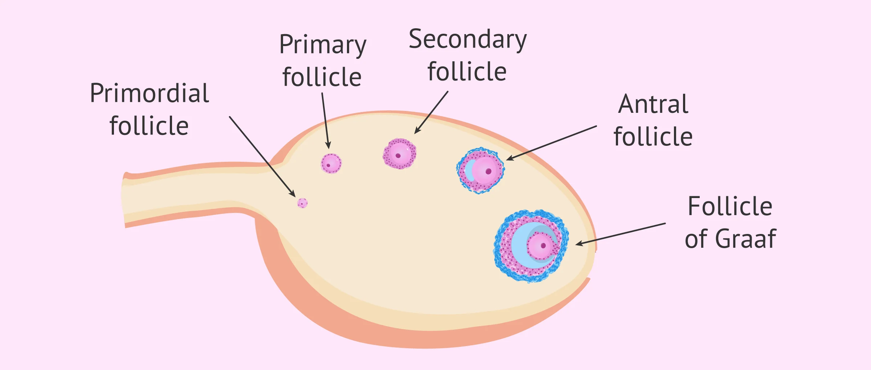
Genetic and Endocrine Control of Gonadal Development
Sex Chromosomes: XX (female) and XY (male) determine gonadal fate.
SRY Gene: Triggers testis development; absence leads to ovaries.
Hormonal Regulation: GnRH from hypothalamus stimulates FSH and LH release.
Modification of Gonadotrophin Release
Pulsatile GnRH: Essential for effective gonadotrophin release.
Environmental Influences: Factors like photoperiod and stress affect hormone levels.
Pharmaceuticals: Hormonal therapies can synchronize breeding in livestock.
Ovarian Functions and Follicular Development
Follicular Stages:
  Primordial → Primary → Secondary → Antral → Ovulation.
Estrogen Production: Promotes follicular growth and endometrial
preparation.
Corpus Luteum: Produces progesterone post-ovulation to maintain pregnancy.

Slide 49
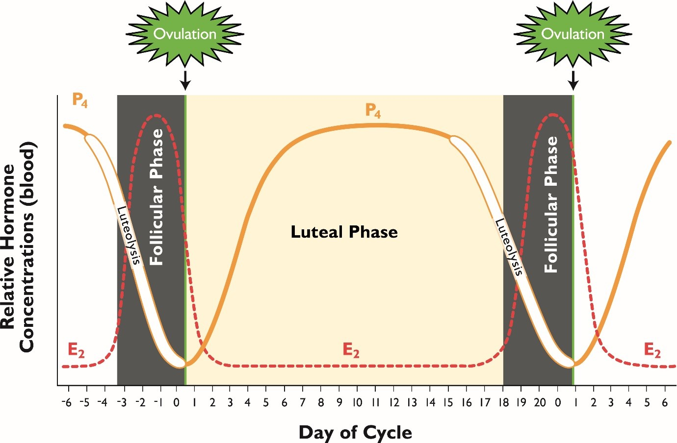
Sexual Receptivity and Ovarian Cycle
Estrous Cycle Phases:
  Proestrus → Estrus (heat) → Metestrus → Diestrus.
Postpartum Activity: First estrus can occur within 30 days after calving.
Ovum Transport and Fertilization
Ovum Transport: Ciliary action and smooth muscle contractions in oviduct.
Capacitation: Sperm undergo biochemical changes in the female tract for fertilization.
Reproductive Cycles in Farm Animals
Hormonal Profiles During Pregnancy: Progesterone maintains pregnancy
Estrogen rises before parturition.
Pregnancy Diagnosis: Hormonal assays (progesterone, pregnancy-associated glycoproteins) used for early detection.
Maternal-Fetal-Placental Participation in Pregnancy
Placental Hormones: hCG supports luteal function; placental lactogen regulates metabolism.
Parturition Process: Hormonal changes lead to uterine contractions and delivery.

Slide 50
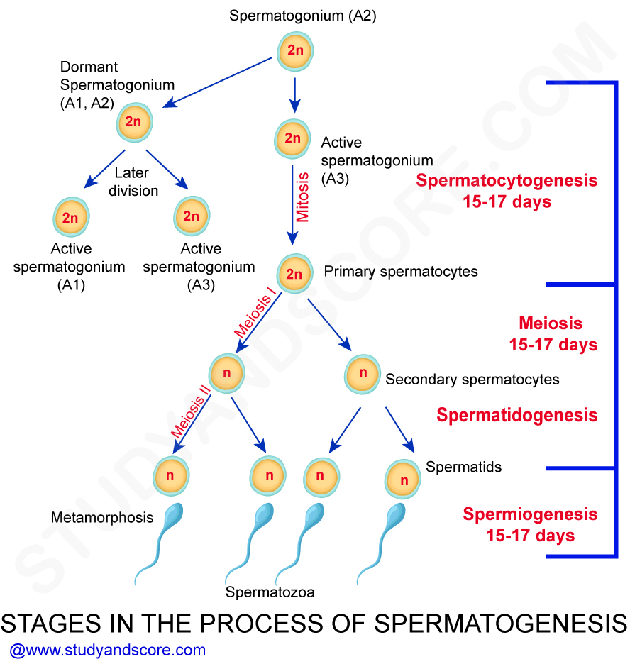
Immunology of Gestation
Maternal Immune Tolerance: Regulatory T cells suppress maternal immune response to fetal antigens.
Research Implications: Understanding immune mechanisms can improve reproductive outcomes.
Preparturient Endocrine Status
Hormonal Preparations for Parturition: Prostaglandins induce contractions
Relaxin prepares pelvic ligaments.
Clinical Applications: Monitoring hormones helps predict
parturition timing and manage complications.
Spermatogenic Cycle and Wave
Spermatogenesis: Process of sperm development in seminiferous tubules.
Stages:
  Spermatocytogenesis (mitosis)
  Meiosis (primary to secondary spermatocytes)
  Spermiogenesis (spermatids to spermatozoa)
Spermatogenic Wave: Asynchronous production of sperm, ensuring a continuous supply.

Slide 51
Function of Sertoli Cells
Nutritional Support: Provide nutrients to developing germ cells.
Hormonal Regulation: Respond to FSH and testosterone to promote spermatogenesis.
Blood-Testis Barrier: Protect developing sperm from immune attack.
Leydig Cells : Location: Interstitial space between seminiferous tubules.
Function: Produce testosterone in response to LH.
Regulation: Testosterone levels are regulated by negative feedback on GnRH and LH.
Semen Composition
Components: Spermatozoa (male gametes)
  Seminal plasma (fructose, prostaglandins, proteins, electrolytes)
Evaluation Parameters:
  Sperm concentration
  Motility
  Morphology
  Viability

Slide 52
Leydig Cells
Location: Interstitial space between seminiferous tubules.
Function: Produce testosterone in response to LH.
Regulation: Testosterone levels are regulated by negative feedback on GnRH and LH.
Testosterone Function and Regulation
Functions:
  Develop male reproductive tissues and secondary sexual characteristics.
  Regulate libido and stimulate erythropoiesis.
Regulation:
Controlled by feedback mechanisms involving GnRH, LH, and FSH.
Cryptorchidism
Definition: Condition of undescended testicles.
Impact on Fertility: Associated with impaired germ cell maturation and increased infertility risk.
Management: Surgical correction (orchidopexy) is recommended.

Slide 53
Puberty and Photoperiod
Puberty: Onset of reproductive capability influenced by hormonal changes.
Photoperiod Influence: Day length affects reproductive hormone secretion, especially in seasonal breeders.
Uses of Androgens, Progestogens, and Estrogens
Androgens: Treat hypogonadism; enhance growth rates in livestock.
Progestogens: Synchronize estrus cycles; manage reproductive disorders.
Estrogens: Induce estrus; therapeutic use for reproductive issues.
Mammary Gland Structure and Development
Structure: Composed of lobules (alveoli), ducts, and connective tissue.
Development Stages:
  Fetal Development: Estrogens stimulate mammary bud growth.
  Puberty: Estrogen and progesterone promote ductal growth.
  Pregnancy: Hormones enhance glandular tissue development.

Slide 54
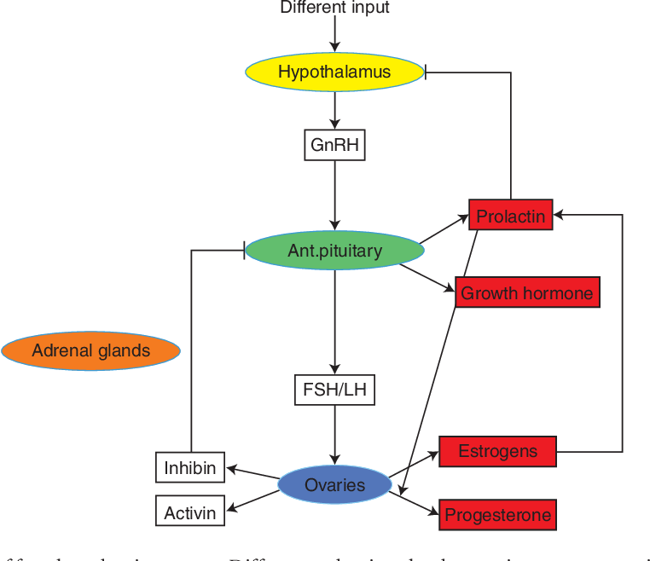
Effects of Estrogens and Progesterone
Estrogens: Stimulate ductal growth.
  Promote epithelial cell proliferation.
Progesterone: Supports alveolar development.
  Inhibits lactogenesis until parturition.
Hormonal Control of Mammary Growth
Prolactin: Essential for milk production; stimulates protein synthesis.
Growth Hormone (GH): Enhances milk production; promotes cell growth.
Oxytocin: Facilitates milk ejection during suckling.
Placental Lactogen: Contributes to mammary growth during pregnancy.
Lactogenesis and Galactopoiesis
Lactogenesis: Stage I (Prepartum): Limited secretory capability develops.
  Stage II (Postpartum): Full activation of lactation; large milk volume secretion.
Galactopoiesis: Maintenance of milk production; influenced by continuous milk removal and hormonal support.

Slide 55
Biosynthesis of Milk Constituents
Proteins: Casein and whey proteins synthesized under hormonal influence.
Fats: Lipids produced from fatty acids and glycerol in the mammary gland.
Lactose: Synthesized from glucose and galactose; requires α-lactalbumin.
Secretion of Milk
Triggered by suckling, leading to oxytocin release, which contracts myoepithelial cells for milk ejection.
Prolactin and the Lactation Cycle
Prolactin promotes milk synthesis; levels increase with suckling stimuli.
Biochemical and Genetic Determinants of Growth
Genetic selection enhances feed efficiency and growth rates.
Hormonal interactions regulate metabolism related to growth.

Slide 56
Factors Affecting Efficiency of Growth
Diet Composition: Nutrient availability impacts growth rates.
Hormonal Regulation: Hormones influence metabolic processes affecting growth.
Environmental Conditions: Stressors impact feed intake and metabolism.
Health Status: Disease can impair growth efficiency through reduced intake or absorption.
Growth in Meat-Producing Animals and Birds
Definition: Growth is the increase in body mass and size due to muscle, fat, and bone accumulation.
Growth Curves
Sigmoid Growth Curve: Follows a typical S-shaped pattern with three phases:
  Lag Phase: Initial slow growth.
  Exponential Phase: Rapid growth as the animal matures.
  Plateau Phase: Growth rate slows as mature size is approached.

Slide 57
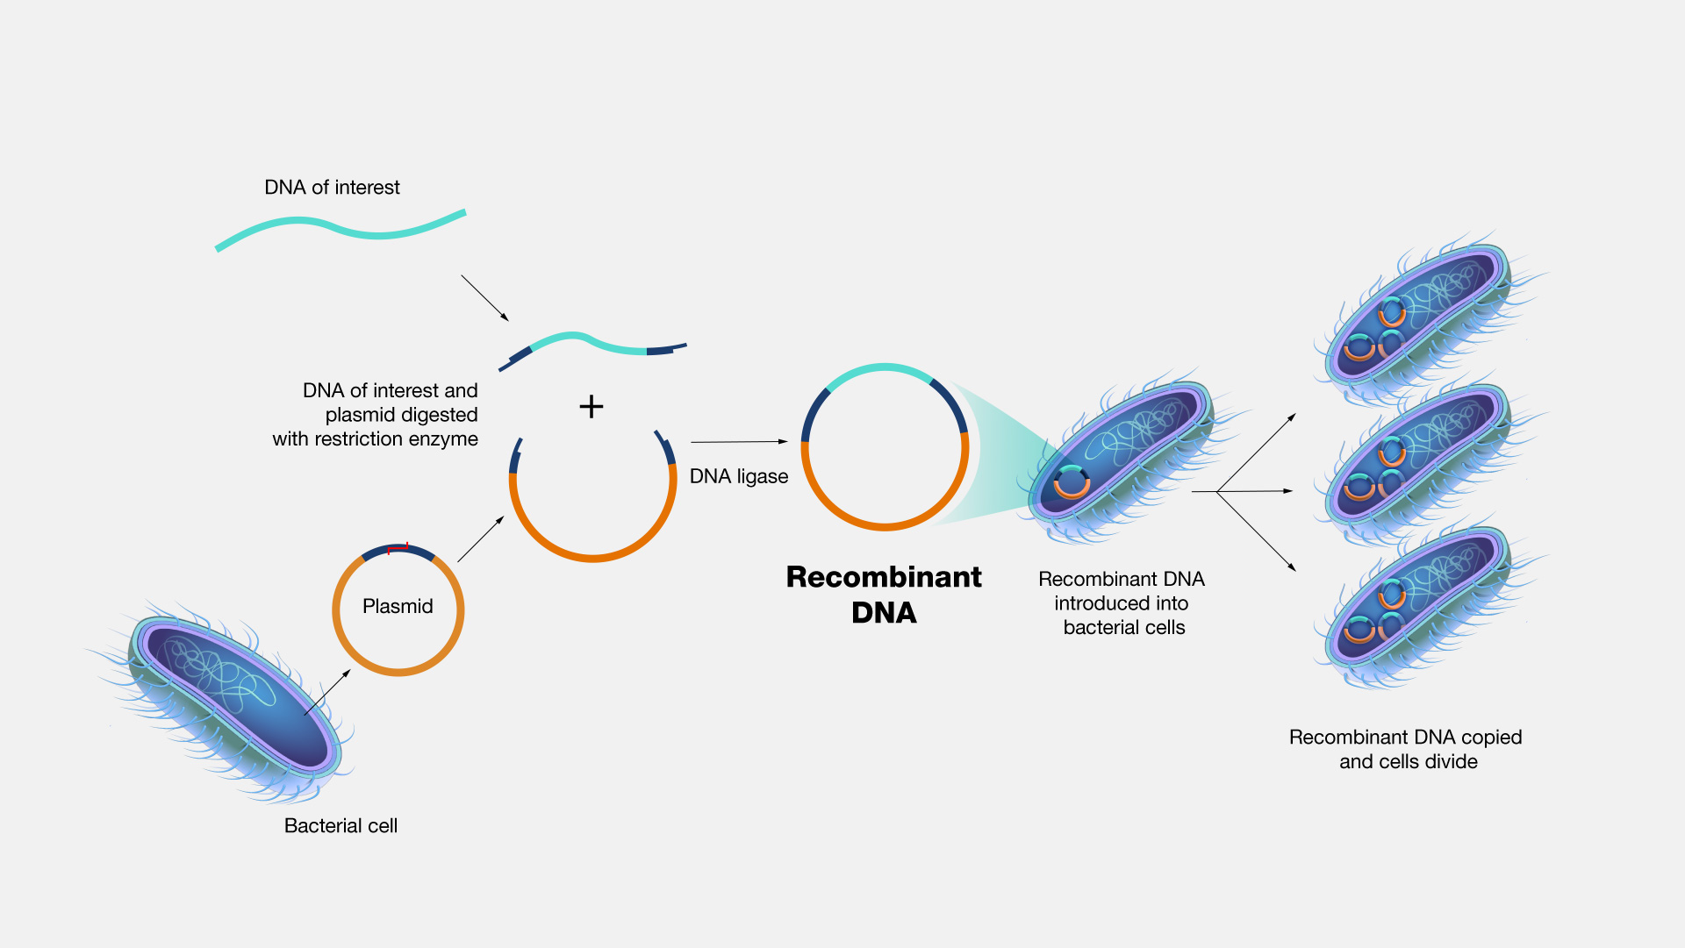
Growth Curve Parameters:
  Parameter a: Theoretical maximum size.
  Parameter b: Growth rate.
  Parameter m: Allometric growth coefficient (typically set at 3/4 for mammals).
  Recombinant Gene Transfer Technologies for Growth Manipulation
Definition: Techniques to introduce specific genes into an organism's genome to enhance traits like growth rates.
Methods:
  Transgenic Techniques: Inserting foreign DNA into the genome.
  Gene Editing (e.g., CRISPR-Cas9): Precise modifications to existing genes.
Advantages: Limitations:
  Ethical concerns regarding genetic modification. Improved growth rates and feed efficiency.
  Regulatory hurdles for GMO approval. Enhanced disease resistance.
  Possible unintended health consequences. Potentially reduced environmental impact.

Slide 58
Protein Deposition in Animals and Poultry
Definition: The synthesis of proteins from amino acids for muscle growth and tissue repair.
Influencing Factors:
  Hormonal Regulation: Insulin, growth hormone, and testosterone promote protein synthesis.
  Nutritional Factors: Adequate protein intake is crucial for optimal deposition.
Protein Metabolism:
  Positive protein deposition occurs when synthesis exceeds degradation.
Heat Balance in Animals
Definition: Equilibrium between heat production and heat loss.
Heat Production:
  Basal Metabolism: Energy for basic functions.
  Activity Metabolism: Energy expended during activities.
  Thermogenesis: Heat from digestion or cold exposure

Slide 59
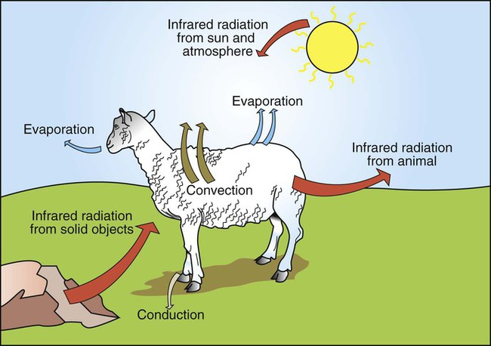
Heat Loss Mechanisms:
  Conduction: Direct heat transfer through contact.
  Convection: Heat loss through air or water movement.
  Radiation: Emission of heat as infrared radiation.
  Evaporation: Loss of heat via moisture evaporation.
2. Thermoregulation Mechanisms
Hypothermia: Body temperature drops below normal, leading to metabolic dysfunction.
Hyperthermia: Elevated body temperature due to excessive heat exposure; can lead to heat stress.
Thermoregulation Strategies:
  Behavioral Responses: Seeking shade, adjusting activity levels.
  Physiological Responses: Sweating, panting, vasodilation, shivering.
3. Role of Skin in Thermoregulation
Provides insulation (fur/feathers) and facilitates heat exchange through blood vessel constriction/dilation.
Sweat glands aid in evaporative cooling in some species.

Slide 60
4. Responses to Heat and Cold
Physiological mechanisms include increased respiration rates during heat stress and altered feeding behavior during cold stress.
Fever: Regulated increase in body temperature to enhance immune function.
5. Hibernation
A state of reduced metabolic activity allowing survival during cold periods with limited food availability.
6. Temperature Regulation in Birds
Maintain body temperature through metabolic heat production, behavioural adjustments, and physiological adaptations (feathers for insulation).

Slide 61
7. Climatology and Environmental Parameters
Important factors affecting animal performance:
  Temperature: Influences metabolism and health.
  Humidity: Affects evaporative cooling; high humidity can exacerbate heat stress.
  Light: Impacts circadian rhythms and reproductive cycles.
  Radiation: Solar radiation increases body temperature.
  Altitude: Decreased oxygen availability affects growth and performance.
  8. Acclimation and Acclimatization
Acclimation: Short-term physiological adjustments to environmental changes.
Acclimatization: Long-term adaptations within populations due to environmental pressures.

Slide 62
Endocrine - Reproductive Functions
HPG Axis: Regulates reproduction via the hypothalamus, pituitary, and gonads.
Key Hormones:
  GnRH: Stimulates release of FSH and LH from the pituitary.
  FSH: Promotes follicular development in females; stimulates spermatogenesis in males.
  LH: Triggers ovulation and androgen production.
  Estrogens & Progesterone: Regulate the female reproductive cycle; prepare uterus for implantation.
  Testosterone: Responsible for male sexual characteristics and spermatogenesis.
2. Circadian Rhythms
Definition: 24-hour cycles in physiological processes (e.g., sleep-wake cycles, hormone release).
Regulation: Controlled by the suprachiasmatic nucleus (SCN) in the hypothalamus.
Melatonin: Secreted by the pineal gland; regulates sleep-wake cycles.

Slide 63
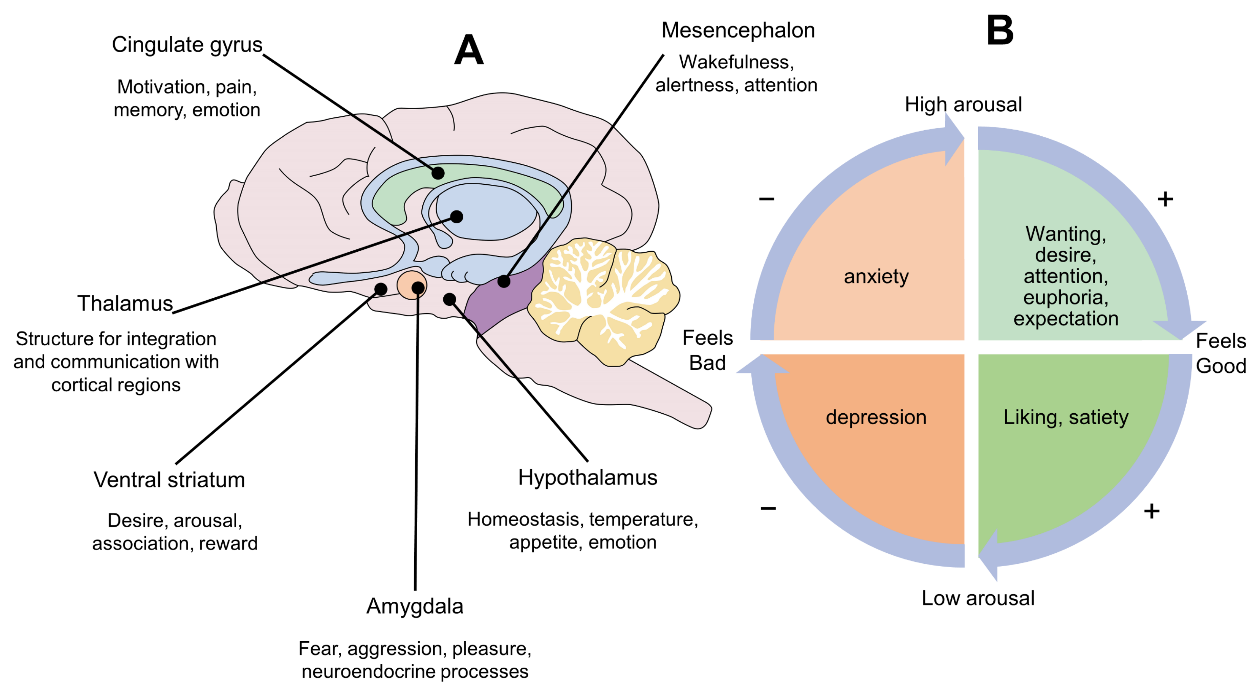
3. Neurophysiology of Behaviors
Behavior: Responses to stimuli mediated by the nervous system.
Types of Behavior:
  Innate Behavior: Genetically programmed responses (e.g., nursing).
  Learned Behavior: Acquired through experience (e.g., training).
  Social Behavior: Interactions within groups (e.g., communication).
4. Communication
Sensory Modalities:
  Visual: Body language, color changes.
  Auditory: Vocalizations and sounds.
  Olfactory: Pheromones and scent marking.
  Tactile: Physical contact and grooming.

Slide 64
5. Learning and Memory
Learning Types: Classical Conditioning: Associating stimuli (e.g., Pavlov's dogs).
  Operant Conditioning: Learning through reinforcement or punishment.
  Observational Learning: Learning by watching others.
Memory Types: Short-term Memory: Temporary information storage.
  Long-term Memory: Permanent information storage.
6. Behavioral Plasticity
Definition: Ability to modify behavior in response to environmental or internal changes.
Importance: Allows adaptation to new situations and enhances survival chances.
7. Clinical Applications
Behavior-Based Medicine: Integrating behavior understanding into veterinary care to improve outcomes.
Behavior Modification Techniques: Using reinforcement and desensitization for behavioral issues.
Psychopharmacology: Medications to manage behavioral disorders (e.g., anxiety, aggression).

Slide 65


